Slide 1
Feature Extraction
Scikit-learn
Gene Olafsen

Slide 2
Overview
Features – the term that is commonly applied to describe the inputs of a machine learning system. ('labels' is the term to describe outputs)
Features are NOT necessarily the raw data that is collected for purposes of interpretation by the machine learning system
Feature Selection and Feature Extraction are commonly grouped under the subject heading of Dimensionality Reduction

Slide 3
Problem solving
Prospect to Account Conversion
Sales Representatives identified by employee number or AD GUID
Sales Regions
Sales Support Teams
Employees – employee number or AD GUID
Role – a role specific to this potential account

Slide 4

Dimensionality Reduction
Feature Selection - filtering irrelevant or redundant features from the dataset.
Feature Extraction - creating a new, smaller set of features that stills captures useful information.
Images and Words are transformed into numerical features.

Slide 5
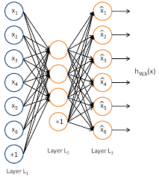
Feature Extraction
Strives to maintain a description of the original data with sufficient accuracy while reducing the number of inputs to the model.
Feature extraction involves reducing the amount of resources required to describe a large set of data.
Some algorithms already have built-in feature extraction.
Deep Learning - extracts increasingly useful representations of the raw input data through each hidden neural layer. These are known as Autoencoders.

Slide 6
A simple case
Weather Data – What kind of feature extraction can you perform?
Location | Wind Mi/Hr | Wind Km/Hr | Rainfall Inches | Rainfall CM
Atlanta | 2 | 3 | 0 | 0
Boston | 3 | 4 | 0 | 0
Chicago | 4 | 5 | 1 | 2.54
Detroit | 4 | 5 | .5 | 1.22

Slide 7
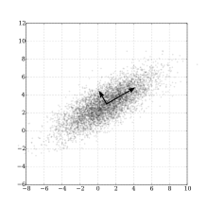
Mention in passing
Principal Component Analysis (PCA)
An unsupervised algorithm that creates linear combinations of the original features. The new features are orthogonal, which means that they are uncorrelated.
Linear Discriminant Analysis (LDA)
A supervised algorithm that maximizes the separability between classes. (must be used with labeled data)
Several kernels are available for each, fast and simple to implement and test.

Slide 8
sklearn.feature_extraction
The sklearn.feature_extraction module can be used to extract features in a format supported by machine learning algorithms from datasets consisting of formats such as text and image.

Slide 9
DictVectorizer SKL-FE1
Implements what is called one-of-K or “one-hot” coding for categorical features.
For situations where there are many encoded features, there will be many zero values. To address the associated memory constraints of dealing with such data- it is recommended to use scipy.sparse matrix instead of numpy.ndarray.

Slide 10
Featurehasher skl-fe2
This class turns sequences of symbolic feature names (strings) into scipy.sparse matrices.
Pro
Offers increased speed and reduced memory usage (over one-hot).
Con
One-way hash is not reversible

Slide 11
CountVectorizer SKL-FE3-5
Commonly used for text processing.
Vectorization the general process of turning a collection of text documents into numerical feature vectors.
Implements both tokenization and occurrence counting in a single class.

Slide 12
Please note...
Better data (quality or quantity) in most cases provides better outcomes than a fancy algorithm.

